Slide 1




Are warming temperatures accelerating fish growth? A case study of Common sole in North East Atlantic waters
Kelly Diaz

Slide 2

Work Plan
August - September: otolith photo taking
October - December: measuring otoliths + gather additional data (temperature and fishing pressure) + literature review
January - February: literature review corrections (January) + data analysis
March: discussion writing
April: first draft
May: corrections
Notes:
Fishing pressure: ICES
Temperature: ISIMIP (The Inter-Sectoral Impact Model Intercomparison Project) or HADISST (Hadley Centre Global Sea Ice and Sea Surface Temperature)

Slide 3
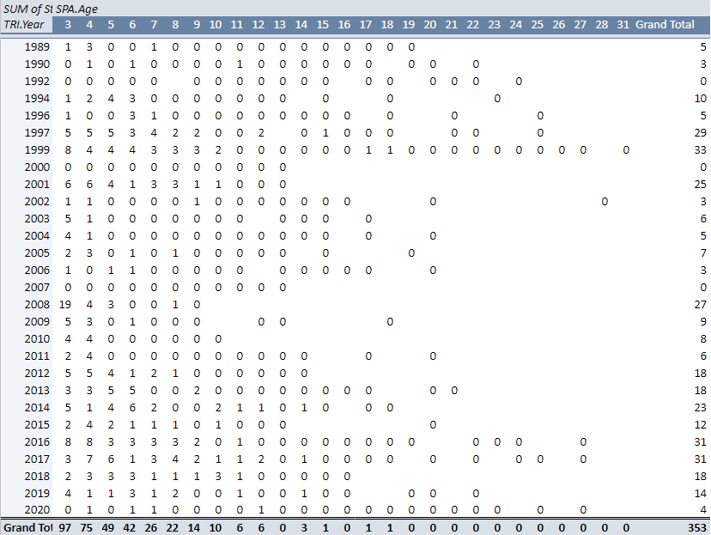
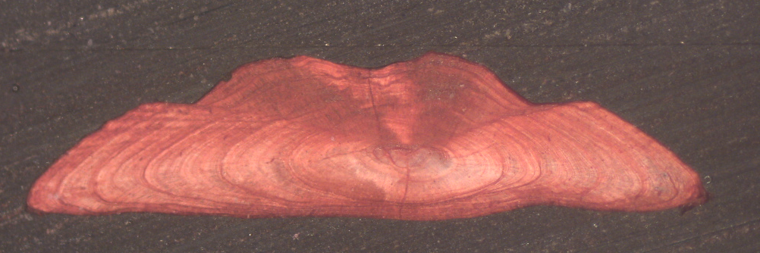
Total Pictures taken
ILVO otoliths: From ~6500 otoliths analyzed, 353 chosen, if
Not broken
Clear shape of nuclei
Clearly readable rings
Age read matches age declared in database
IFREMER otoliths: 2012 - 2017

Slide 4
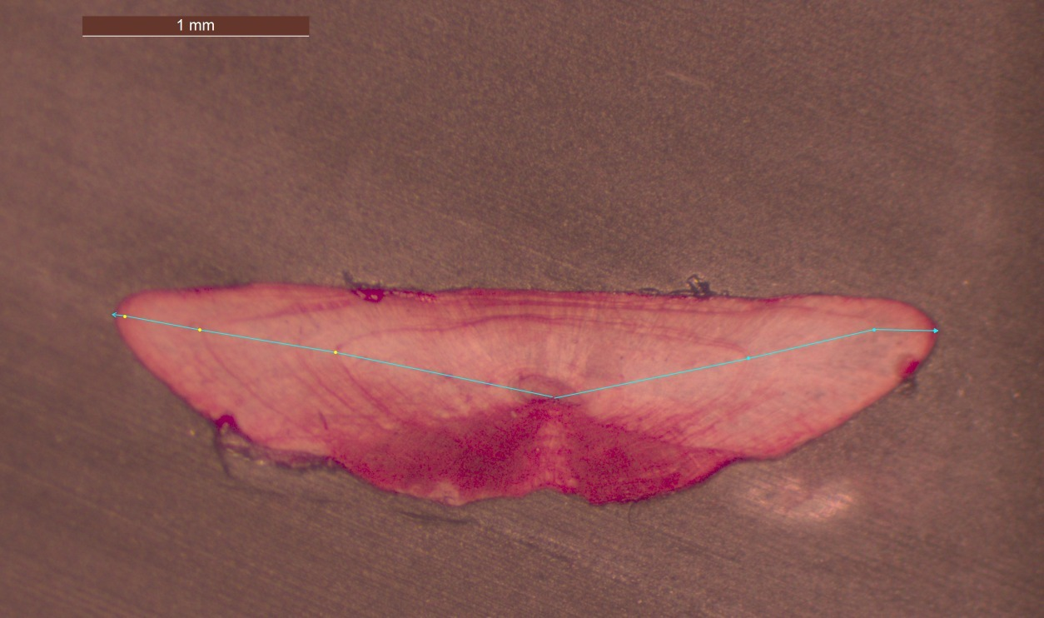
Current steps: Measuring
Measurement: SmartDots software
Taking: total length of otolith + ring length (each side separately)
Considering if: nuclei has a clear round shape
Notes:
Tools/ methodology/type of work that is planned
Find the linear regression formula

Slide 5
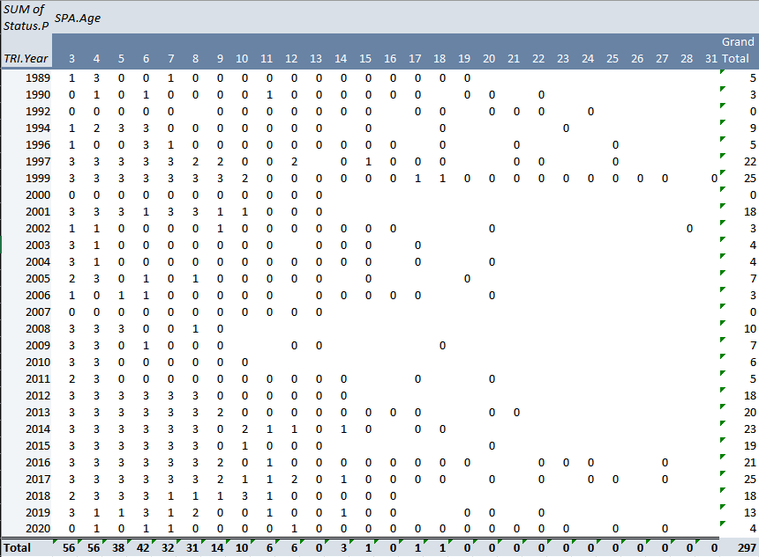
Total Measurements taken (approximation)
Measurements will be taken:
3 replicas per age category
Clear shape of nuclei
Clearly readable rings
IFREMER otoliths: 2012 – 2017
Total approximate ~300. Ages mostly <10 years old
Considering option: Returning to ILVO to take additional pictures (age read in otolith close to age in database) – possibly Jan or Feb

Slide 6
Current steps: Literature Review
First submission: 17 December 2022
Deadlines:
February: 3 February 2023
Notes:
Tools/ methodology/type of work that is planned
Find the linear regression formula

